Slide 1
Crime Rates in Chicago
Nojus Satikauskas || C00261186

Slide 2

introduction
I'll investigate Chicago, USA's crime statistics. In metropolitan areas like Chicago, the consequences of crime on both communities and individuals are complicated.
Apart from inflicting pain on the victims, it also undermines public trust, hinders economic growth, and presents challenges for law enforcement and local authorities.

Slide 3

Rationale
Understanding the complexity of crime in Chicago is essential to developing community resilience and efficient solutions. My investigation looks for novel patterns, high-risk areas, and underlying dynamics using data-driven approaches.
The ultimate goal is to identify trends in crime rates by in-depth data analysis, which can then be utilized as a basis for developing measures to counteract these trends.

Slide 4
Research problems
Through an analysis of crime typologies, spatial variances, and temporal trends, this study tackles the complexity of urban crime in Chicago. The investigation is guided by several key topics, such as the use of temporal analysis to pinpoint offending peaks and variables affecting crime rates.
The objective of district-level analysis is to identify areas of high criminal activity and evaluate geographical differences in crime rates in Chicago.
For the sake of public safety, knowing crime typologies aids in resource prioritization and the customization of responses to common transgressions.
Examining data anomalies and patterns highlights new problems and areas that need more research.

Slide 5
Scope of analysis
ID: Unique identifier for each crime incident
Case Number: Case number associated with the incident
Date: Date and time of the incident
Block: Address block where the incident occurred
Primary Type: Primary classification of the crime
Description: Detailed description of the crime
Location Description: Description of the incident location
Arrest: Indicates if an arrest was made
Domestic: Indicates involvement of domestic violence
District, Ward, Community Area: Geographic location information
FBI Code: FBI classification code for the crime
Latitude, Longitude: Geographic coordinates of the incident location
From 2001 to 2023, there are more than 50,000 values in this Kaggle-sourced dataset. Using a range of perspectives and in-depth analysis, intriguing new findings regarding the distribution of crimes in Chicago have been made public. These findings could direct evidence-based policy decisions.

Slide 6


Main analysis

Slide 7
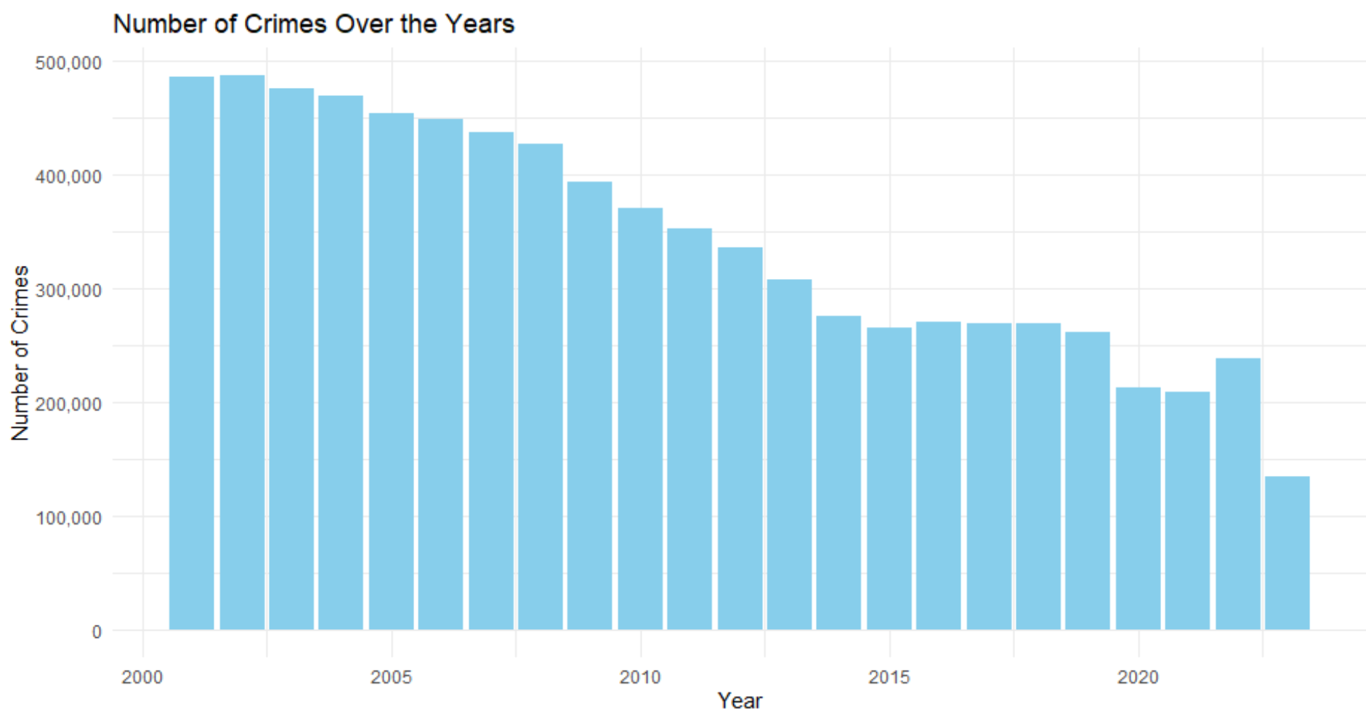
The graphic illustrates a clear pattern in which crime rates have dropped significantly since their highest point in the early 2000’s.
Temporal Patterns of Crime

Slide 8
Possible Reasons
The possible reasons for this graph are as follows:
A number of variables, including improved police enforcement tactics, community outreach initiatives, investments in social services and education, technological improvements, demographic shifts, and economic upheavals, can be blamed for the drop in crime in Chicago between 2002 and 2023.

Slide 9
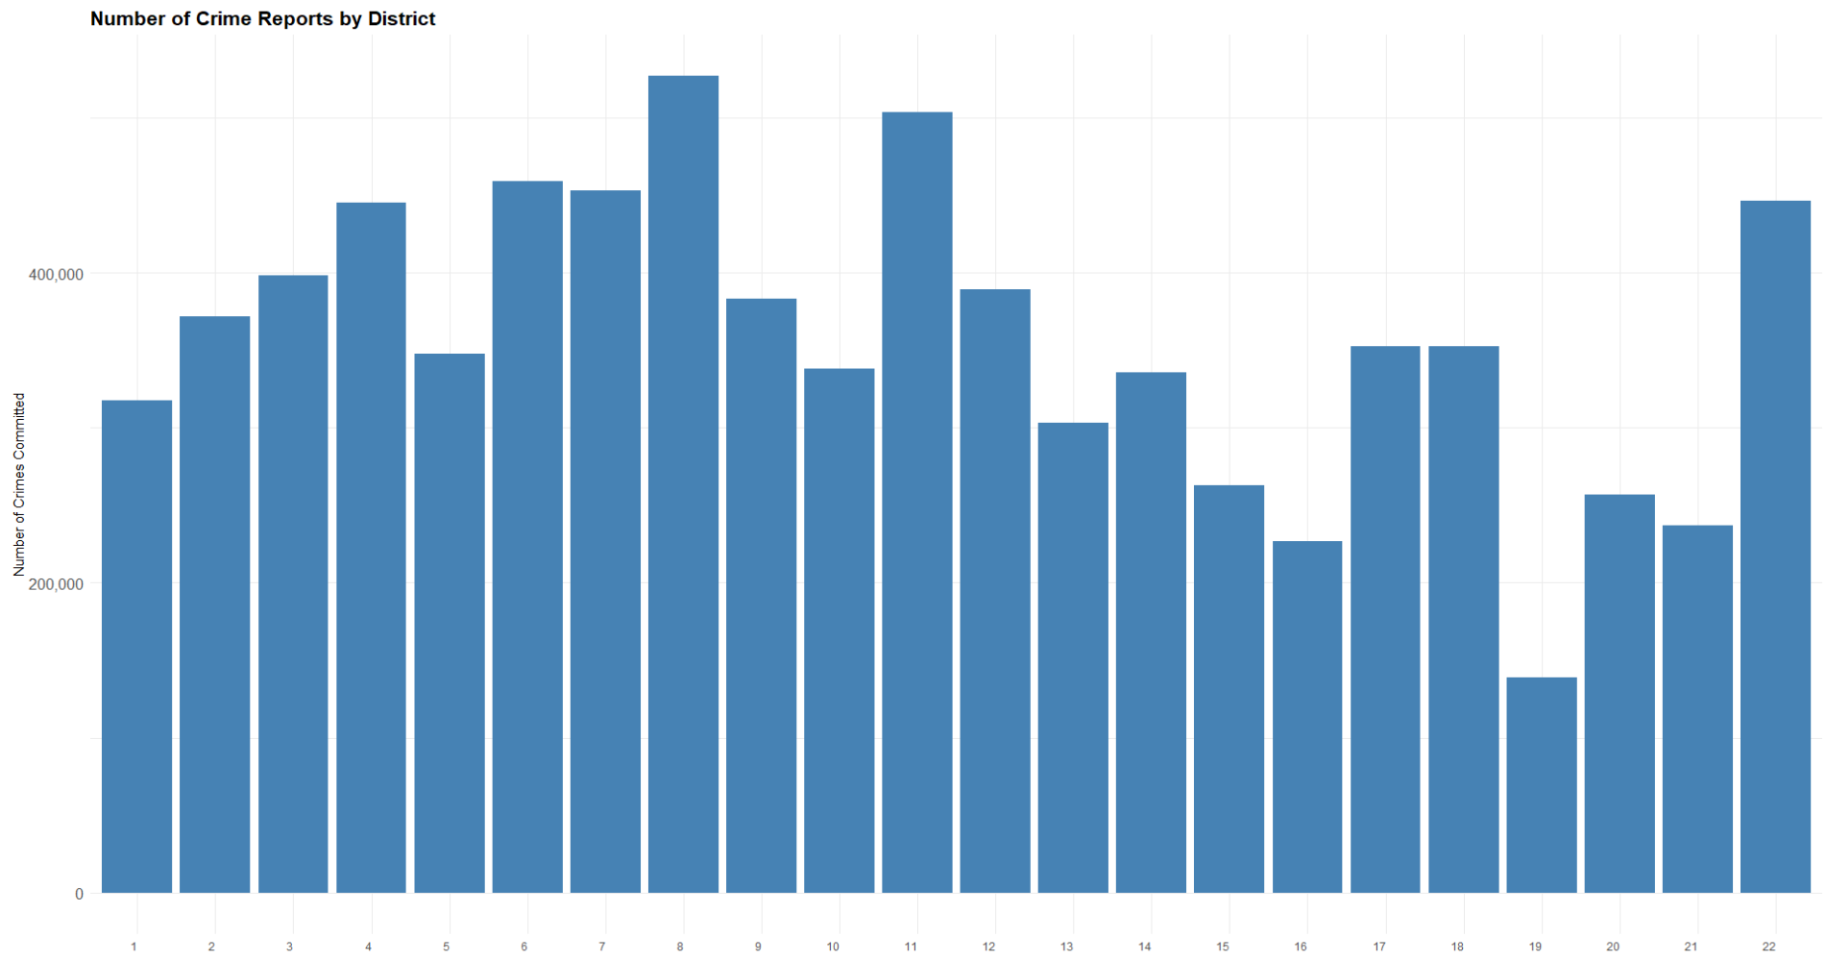
Crime's Spatial Distribution:
Spatial analysis improves our understanding of Chicago's crime distribution by highlighting hotspots of criminal activity and disclosing differences in crime rates between districts.

Slide 10

Result
Potential reason for crime-rate
Possible solution
The districts 8, and 11 exhibit a significant concentration of crime, indicating specific tendencies in Chicago.
The designation of high-crime zones affects law enforcement strategies, urban renewal, and community involvement. Patrols, monitoring, and interventions can be directed toward specific areas to disrupt criminal networks and deter criminal conduct.
Socioeconomic variables like unemployment and poverty in these places can push people to turn to crime as a last resort or as a method of surviving.

Slide 11
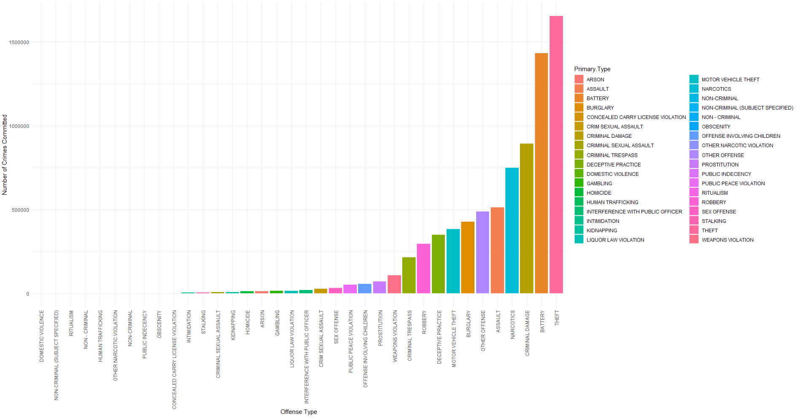
Crime typologies

Slide 12


results
Since non-violent crimes like theft take advantage of weakened security or easy targets, they are more prevalent in Chicago.
Potential reasons
Thoughts on results
Offenders may prefer non-violent crimes over violent ones, exhibiting a risk aversion, because violent crimes carry more risks and harsher legal ramifications.
The disparity in Chicago's crime rates between violent and non-violent crimes is a result of social conditions as well as underlying criminal behavior patterns.

Slide 13

Potential solutions
Give priority to strategies to combat non-violent crimes by bolstering security, improving surveillance, and tackling root causes such as drug addiction and destitution.
Implement community-based initiatives for youth participation, crime prevention, and social support networks to create safer areas.

Slide 14

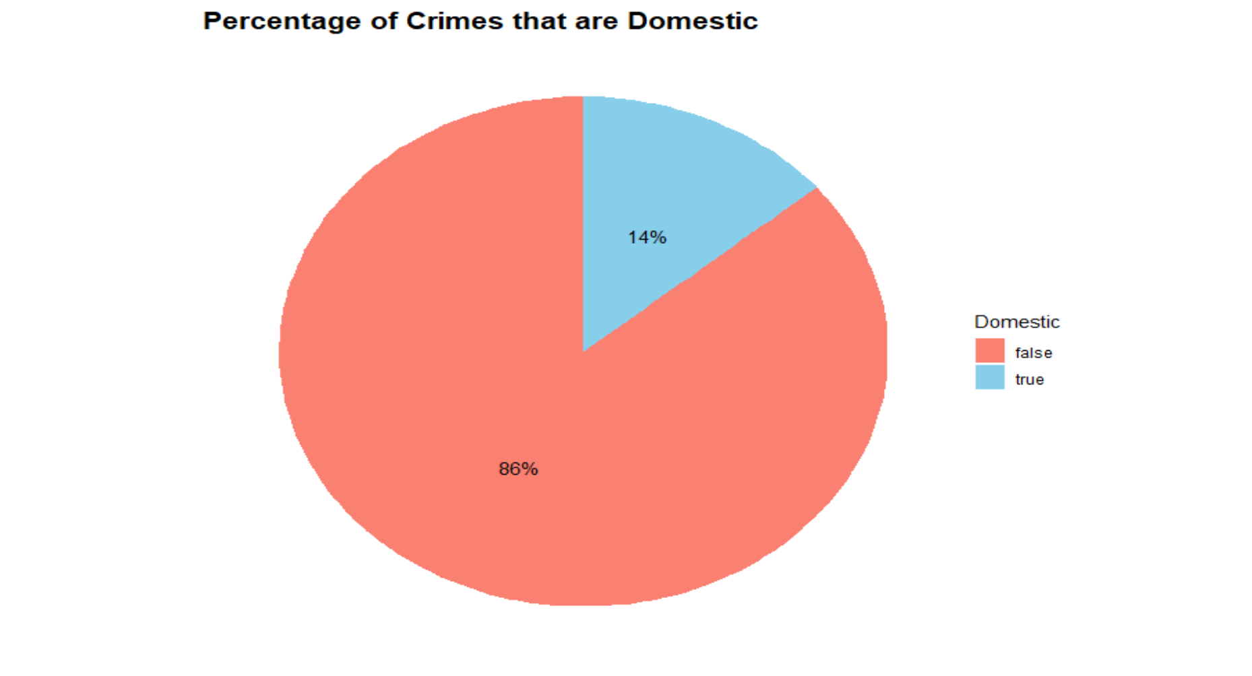
Domestic Crime
Approximately 14% of reported crimes in Chicago are classified as domestic incidents, shedding light on the significant impact of interpersonal dynamics within households or among individuals with preexisting relationships on the city's crime landscape.

Slide 15
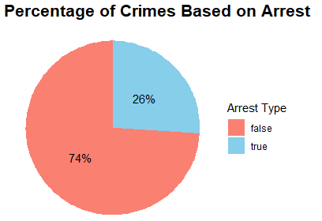
Low Arrests
With only a 26% arrest rate for reported crimes in Chicago, challenges such as insufficient evidence, witness reluctance, and systemic limitations hinder successful apprehension. These factors underscore the complexity and difficulty of resolving criminal cases effectively within the city.

Slide 16
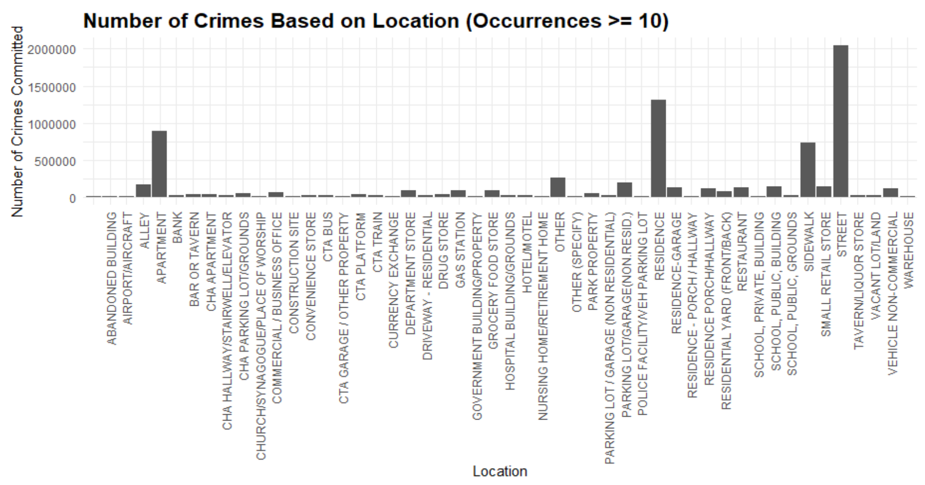

crime environment
Reported crimes happen most often in 3 places That being:
The Street
Apartments
Residences

Slide 17
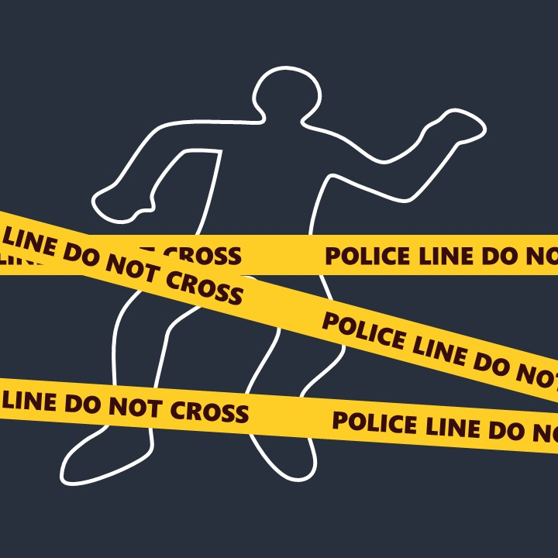
Limitations
One of the negatives is the dataset's quality, which may contain biases and inaccuracies as a result of missing and duplicate data.
Certain crimes and places may be underrepresented as a result of coverage gaps.
Furthermore, it is challenging to conduct a more thorough analysis of Chicago's crime trends and underlying causes due to the paucity of data on socioeconomic characteristics and environmental circumstances.

Slide 18
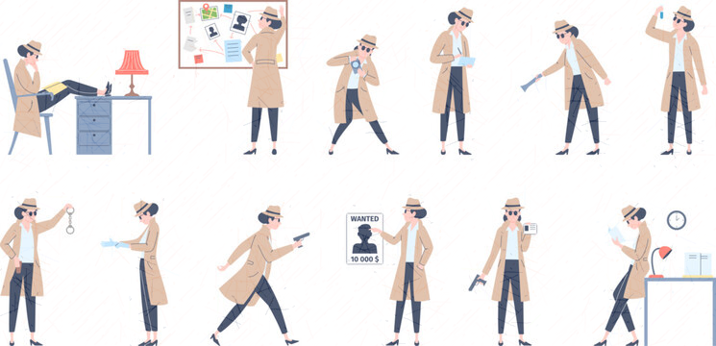
Further research
Qualitative Research
Qualitative methods such as focus groups and interviews help researchers gain a deeper understanding of the perspectives of community members affected by crime.
This makes it possible for academics to create elaborate plans that are customized to the community's requirements.

Slide 19

References
Crimes in Chicago dataset: Kaggle
Images: detective, ice cream, crime-scene, hand-cuffs, mugshot Graphs sourced from: My github

